Slide 1
Sales Analysis Dashboard
DS – 620 Data Visualization
Harsha Chakravarthy Bellamkonda

Slide 2
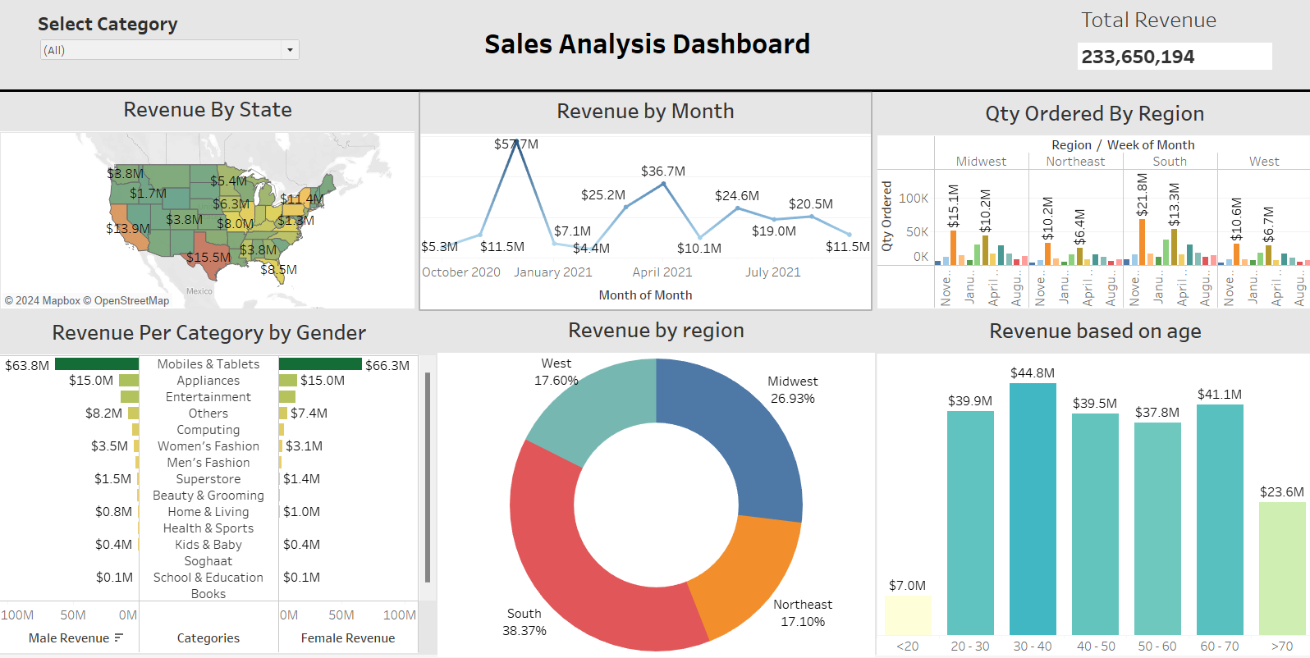
Sales Analysis Dashboard

Slide 3
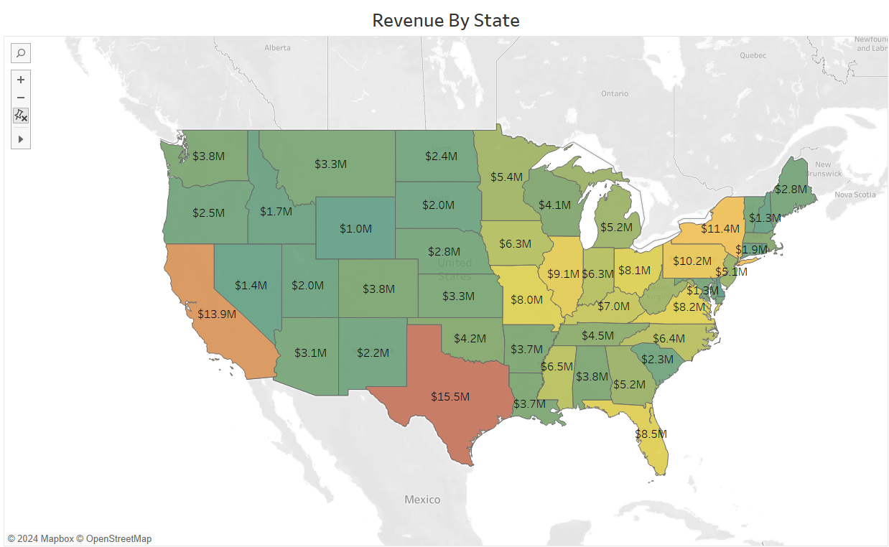
Revenue by State
Here the graph shows revenue generated by state.
This graph illustrates the revenue distribution in several states. Darker tones indicate more revenue, whereas lighter shades indicate less revenue. The southern states generate the most revenue, with Texas, Florida, and California leading the way.

Slide 4
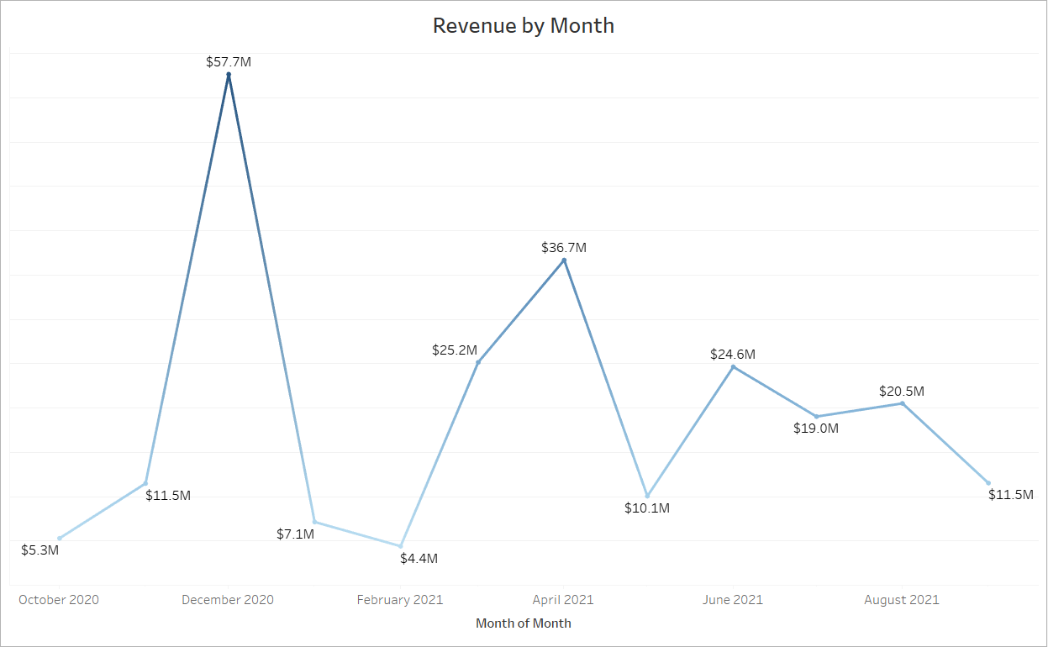
Revenue by Month
Here the line graph shows revenue generated by month.
This line chart displays monthly revenue trends over the last year. The largest income was reported in December 2020, as is common during the holiday season. There are substantial revenue peaks in April and July 2021.

Slide 5
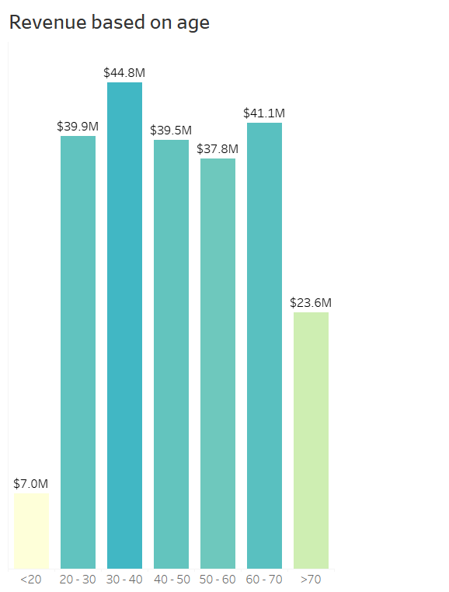
Revenue based on age
Here the bar graph shows revenue generated based on age.
This bar chart shows revenue distribution across various age groups. The age group 30-40 had the largest revenue, followed by the 40-50 and 50-60 age groups. The revenue for the under-20 and over-70 age groups is much lower.

Slide 6
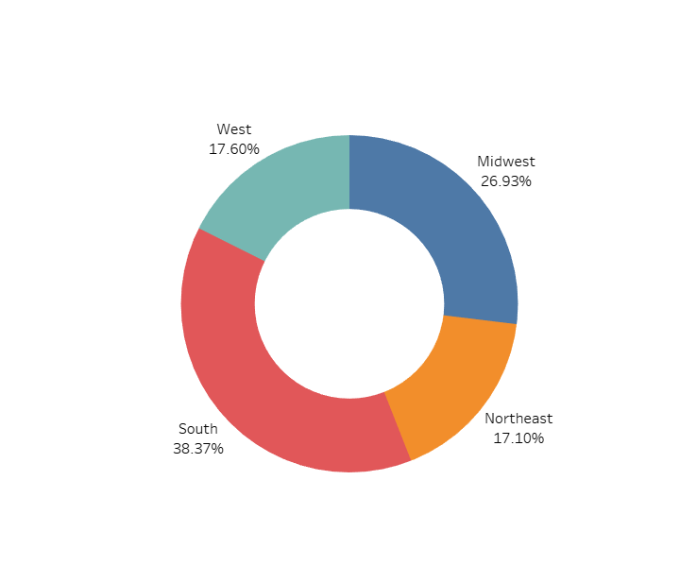
Revenue by Region
Here the pie chart shows revenue generated by region.
This pie chart shows the revenue contribution by region. The South generates the most revenue (38.37%), followed by the Midwest (26.93%), the West (17.60%), and the Northeast (17.10%).

Slide 7
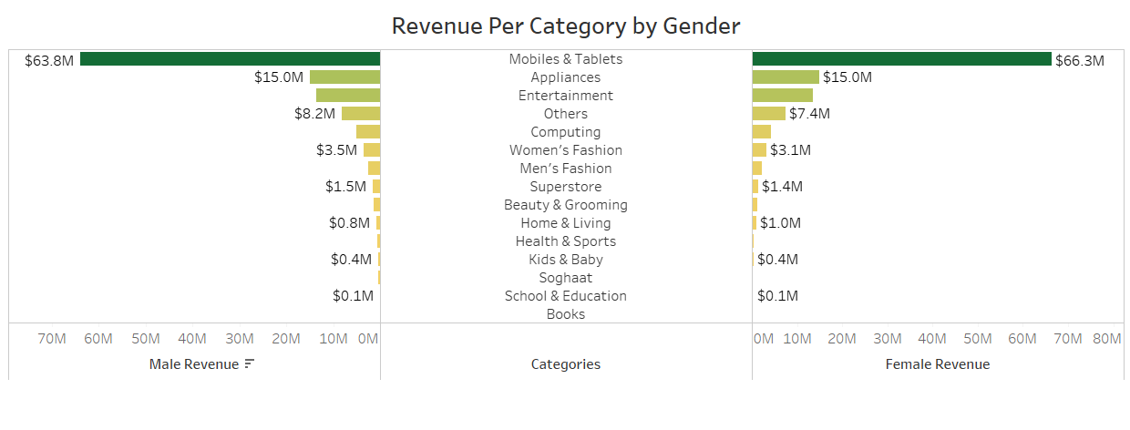
Revenue per category by gender
Here the bar graph shows revenue generated per category by gender.
This bar chart shows the revenue distribution across several product categories, divided by gender. Mobiles and tablets provide the most revenue for both men and women, followed by Appliances and Entertainment. There is a clear gender difference in categories such as Women's Fashion and Men's Fashion.

Slide 8
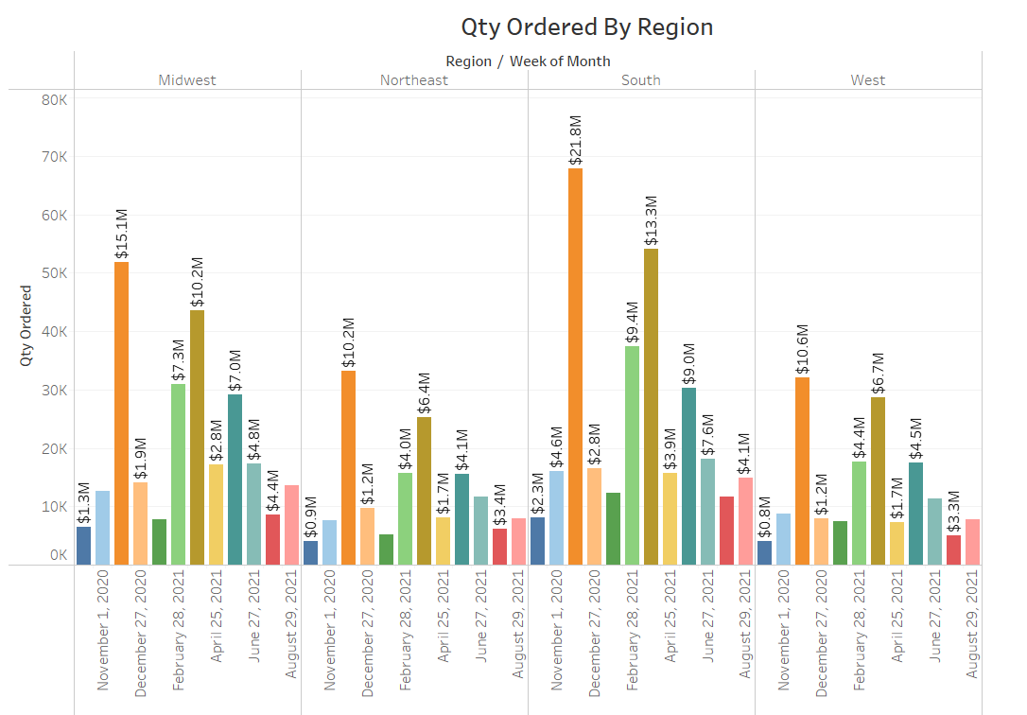
Quantity Ordered By Region
Here the bar graph shows quantity ordered by region.
This bar chart displays the number of things ordered by region, organized by week of the month. The biggest quantity ordered is seen in the South area in December 2020, with noticeable peaks in other months for different regions.

Slide 9
Conclusion and Recommendations
Summary:
The report emphasizes significant revenue trends across states, months, age groups, regions, and product categories by gender.
Recommendations:
To optimize sales, focus your marketing efforts on high-revenue states and months.
Tailor marketing techniques to the 30-60 age range.
Increase market presence in the South while pursuing growth prospects in the Northeast and West.
Create gender-specific marketing strategies for categories with significant purchasing discrepancies.
Ensure adequate supply and arrange targeted promotions for peak demand periods in the South region.

